Slide 1
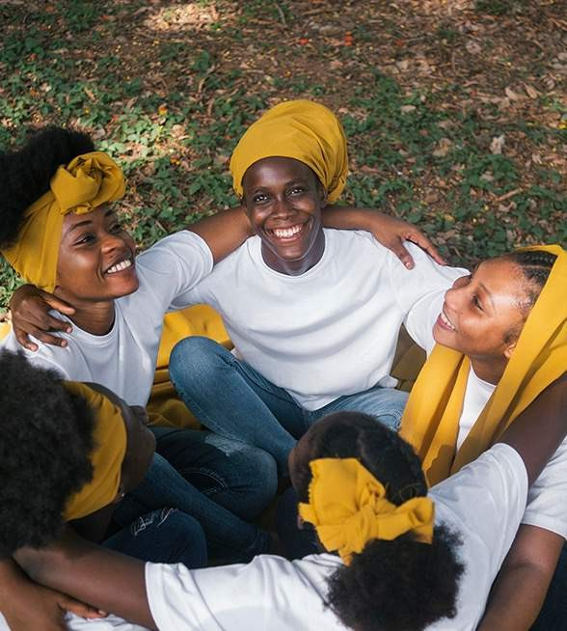
Social Impact
Health and Sustainable Development Goals
Presented By: Nwoko Gloria Chinyere

Slide 2
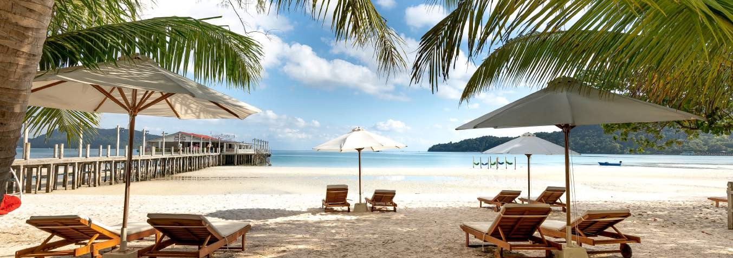
Millennium Development Goals
There are 17 goals set by the United Nations at the end of The Millennium Development Goals (MDGs) in 2015.
These goals tagged as The Sustainable Development Goals (SDGs) are expected to be achieved by 2030. The goals are:
01
02
03
End Poverty
End poverty in all its forms everywhere
End Hunger
End hunger, achieve food security and improved nutrition and promote sustainable agriculture.
Ensure Healthy lives
Ensure healthy lives and promote well- being for all ages.
04
05
06
Ensure quality Education
Ensure inclusive and equitable quality education and promote lifelong learning opportunities for all.
Gender Equality
Achieve gender equality and empower all women and girls.
Water and Sanitation
Ensure availability and sustainable management of water and sanitation for all.

Slide 3
07
08
09
Access to Affordable Energy
Ensure access to affordable, reliable, sustainable and modern energy for all.
Economic Growth
Promote sustained, inclusive & sustainable economic growth, full and productive employment and decent work for all.
Resilient Infrastructure
Build resilient infrastructure, promote inclusive and sustainable industrialization and foster innovation.
10
11
12
Reduce Inequality
Reduce inequality within and among countries.
Safe Human settlements
Make cities and human settlements inclusive, safe, resilient and sustainable.
Sustainable Consumption
Ensure sustainable consumption and production patterns.
13
14
15
Combat Climate change
Target urgent action to combat climate change and its impacts.
Conserve Ocean and seas
Conserve and sustainably use the oceans, seas and marine resources for sustainable development.
Ongoing Education
Protect, restore & promote sustainable use of terrestrial ecosystems, manage forests, combat desertification & reverse land degradation & biodiversity loss.

Slide 4
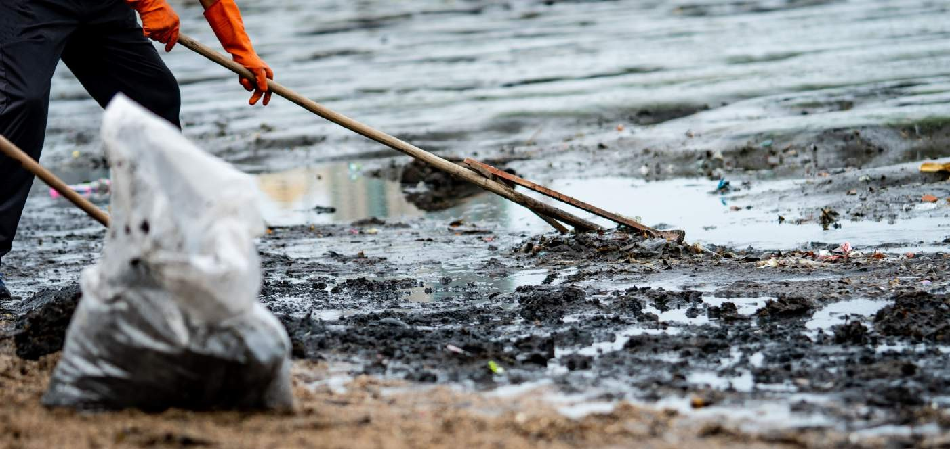
16
17
Access to Affordable Energy
Ensure access to affordable, reliable, sustainable and modern energy for all.
Economic Growth
Promote sustained, inclusive & sustainable economic growth, full and productive employment and decent work for all.
All these goals are intertwined towards achieving sustainability in the UN member countries.
The importance of health and well-being at every stage of one’s life
cannot be overemphasized which is why efforts have been made to improve people’s health at all cost.
In respect of this,
The goal 3 (ENSURE HEALTHY LIVES AND
PROMOTE WELL BEING FOR ALL AGES) of the sustainable
development, gives us a health expectation for all UN member
countries.

Slide 5
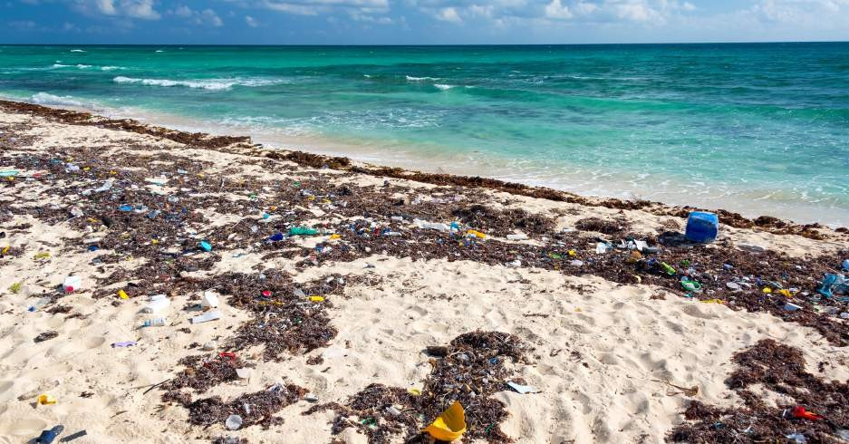
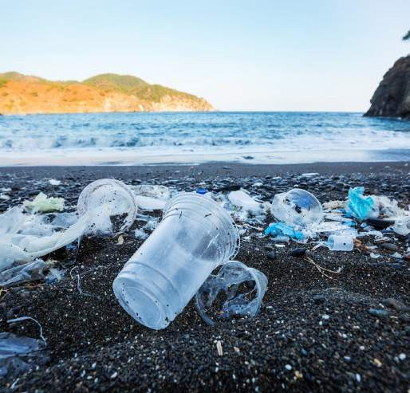
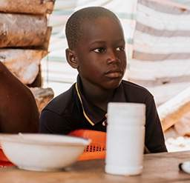
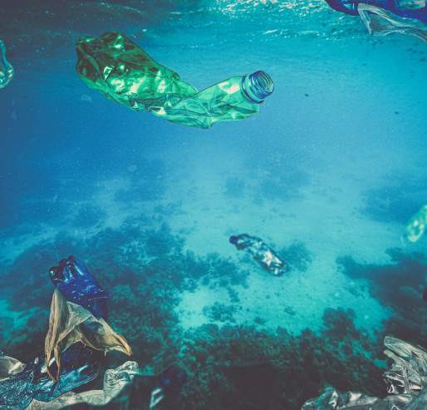
Common Health Issue
In Nigeria, people face several health challenges such as: maternal health, malnutrition, HIV/AIDS, malaria, typhoid fever, STDs, chicken pox, and other communicable diseases. These however, have hindered the success of the Sustainable Development Goal 3. Of all these health issues, maternal health, malaria and typhoid fever are the most common and have become a pain point in Nigeria communities.
.
The Main Problem
Communicable diseases.
Malnutrition and food scarcity.
Erosion and Habitat Loss
Economic Impact on Local Community

Slide 6

As long as Nigeria have poor sanitation, inadequate access to clean water, limited hygiene practices and a tropical climate conducive to mosquito breeding, typhoid and malaria remains a significant health challenge in Nigeria and will not stop contributing to a substantial portion of the country’s disease burden.
On the other hand, Nigeria is also faced with the challenge of maternal health as a result of limited access to quality healthcare during pregnancy, insufficient skilled birth attendants, and socio-economic factors which is prevalent in the northern part of the country.
ACCESS TO HEALTHCARE SERVICES
Significant portion of Nigerians still lack access to vital healthcare services as a result of disparities in the society. On the other hand, the healthcare sector is not meeting the demand of implementing effective preventive measures. To fill this gap and achieve our common objective of health for all, addressing disparities is critical to ensure equitable healthcare provision for all irrespective gender, background, race, status or whatever it may be.

Slide 7


How can I actually help?
The primary purpose of this initiative is to
Enhance Community
Livelihoods
Thirdly, I can also raise awareness in my small community and across through series of sensitization programs (physical and online) about the importance of having a good health through proper self-care, environmental sanitation, the need of going for antenatal and adhering to the instructions during pregnancy; and the danger of marrying out premature girls as it is common in the northern part of Nigeria.
Setting the standard of self health protection
First and foremost, I can help by protecting and promoting my own health by taking the necessary measures of typhoid and malaria prevention. By so doing, I will be setting an example for those around me to follow.
Promote Community Awareness
I can remind the government and other leaders of their commitment and promise to improve the health care, and the people’s access to health.
This project aims to create a sustainable model for coastal management that balances ecological integrity with community well-being and economic viability.

Slide 8
Implementation and way forward
Sufficient Supply of Mosquito Nets
Conduct sufficient supply of mosquito nets across all healthcare facilities in the country.
Improved Sanitation
Create Waste management systems, promoting community awareness, and ensuring access to clean water sources.
Improved Vaccination
Establishing accessible vaccination clinics, conducting community outreach programs.
Proper food and water testing
Proper food and water testing, are essential for controlling and preventing typhoid and malaria.
Pollution Control
Execute erosion mitigation strategies to protect and restore the shoreline.
Community Engagement
Involve residents in conservation efforts and sustainable practices.
Monitoring and Feedback
Regularly monitor progress and adapt strategies as needed.

Slide 9




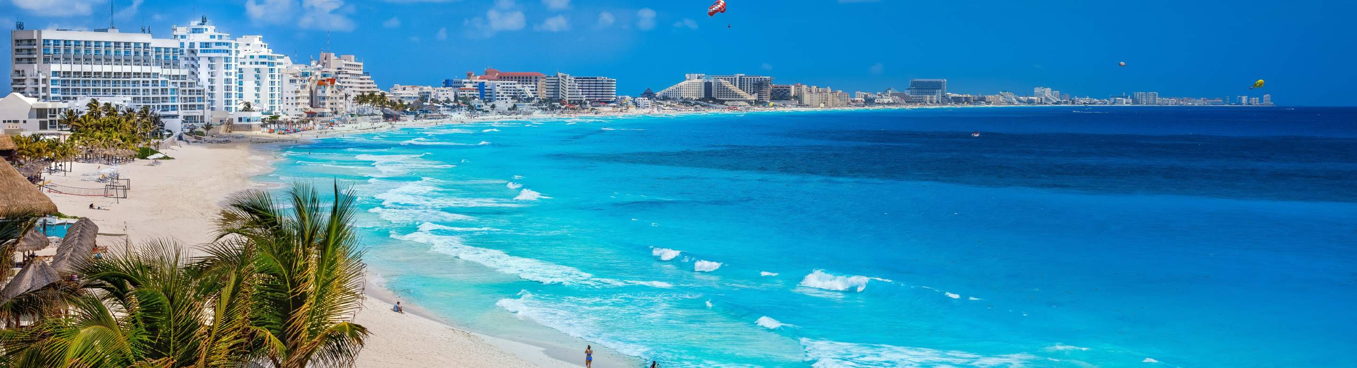
Targets and Beneficiaries
Local Community
Marine Life
The project at Ikeduru primarily targets and benefits
Tourists and Visitors
Future Generations

Slide 10
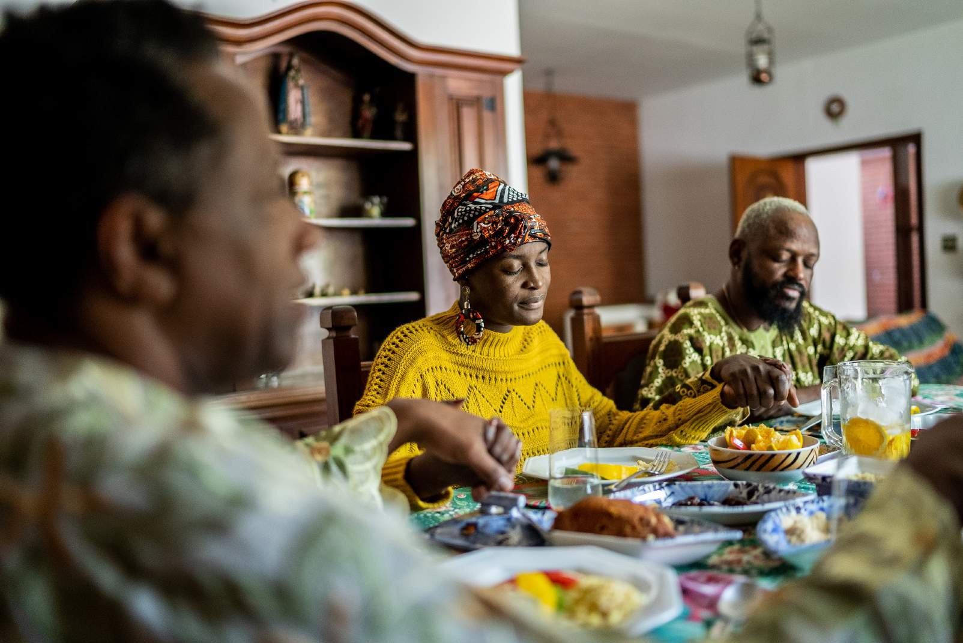


Thank You
Let's transform and Revolutionize Tomorrow with Social Impact.
Contact
rosariagloria93@gmail.com
+234 803 890 9678

